Slide 1
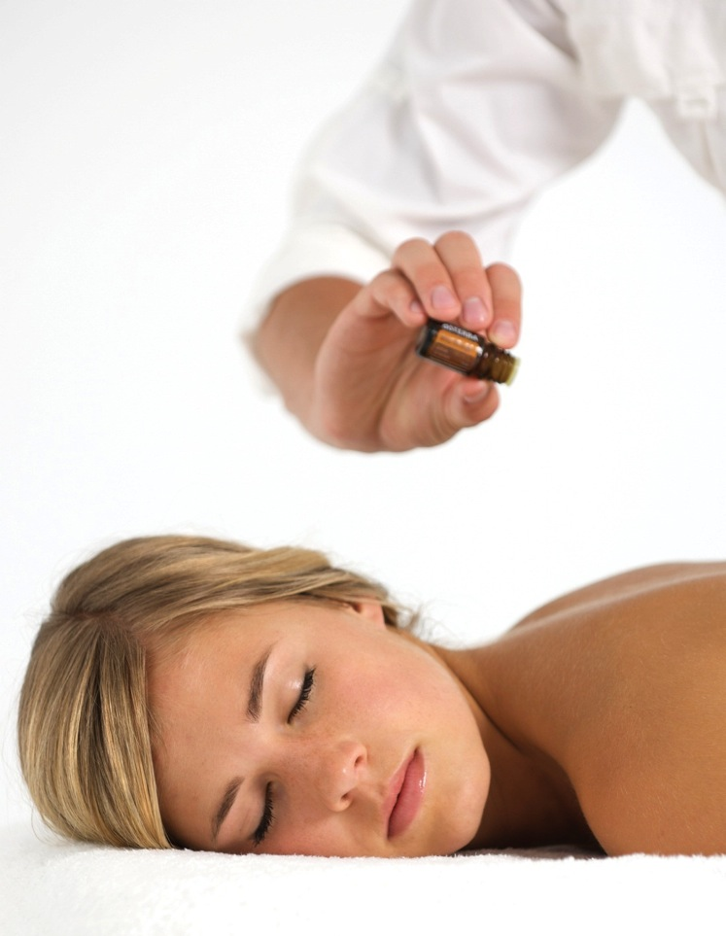

Slide 2
Clinical approach
Built around the oils
Simple but effective
Results duplicable
Teachable
Specific pattern of strokes and movement through know body meridians to affect a balanced return to homeostasis.

Slide 3
Sympathetic
Parasympathetic
Increased Heart Rate and Breathing
Dilation of Blood Vessels
Bronchial Dilation
Pupil Dilation
Increases Sweat Production
Constricts Pupils
Decreases Heart Rate
Increases Gastrointestinal Function
Expels Waste
Homeostasis
Notes:
See neuroanatomy page 90. Another name for autonomic tone is homeostatsis. The body needs to be in balance in or to function properly. The body is in a constant state of flux and adaptation. It reacts to the variables in our body and in our environment.

Slide 4
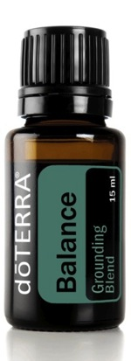
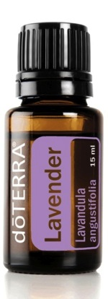
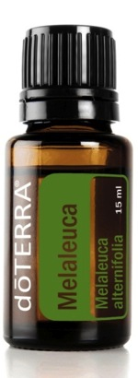
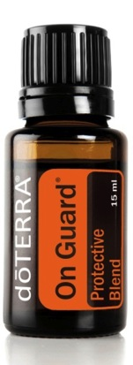
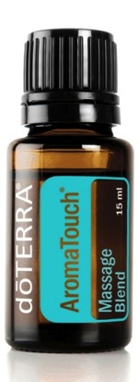
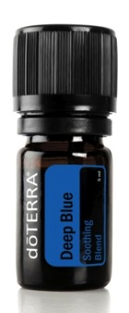
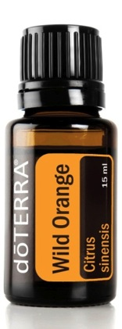
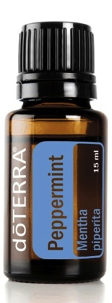
ESSENTIAL OILS WITHIN THE AROMATOUCH TECHNIQUE
STRESS MANAGEMENT
IMMUNE SUPPORT
INFLAMMATORY RESPONSE
AUTONOMIC IMBALANCE

Slide 5
ZONES & VISCERA
Modern science has documented that there are five known energy zones on each side of the body; together these ten zones represent a complete correlation to body systems and specific viscera.
There are three body parts known to contain entire visceral contact point access: the hands, feet, and ears.

Slide 6
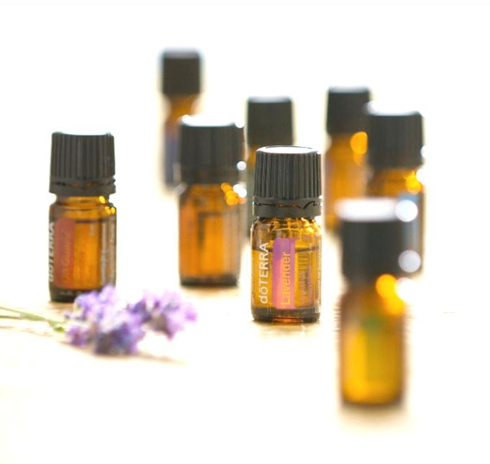
How are Aromatouch and Symphony of the Cells Similar?
Both done on the spine – highest amount of tissue central nervous system
Both enhance neurological activity – the most nerve endings to communicate
Stimulate blood flow
Both created around the use of oils
Cleanse (drink water!)

Slide 7
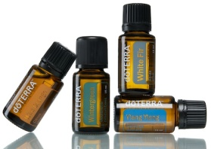
How are they different?
Aromatouch
Symphony of the Cells
Same 8 oils
Technique is important
Aroma is wonderful
35-60 minutes
Same outcome
Create homeostasis
Each spinal different
Not about technique
Aroma isn’t always good
5-10 minutes
Different outcomes
Support Body Systems

Slide 8
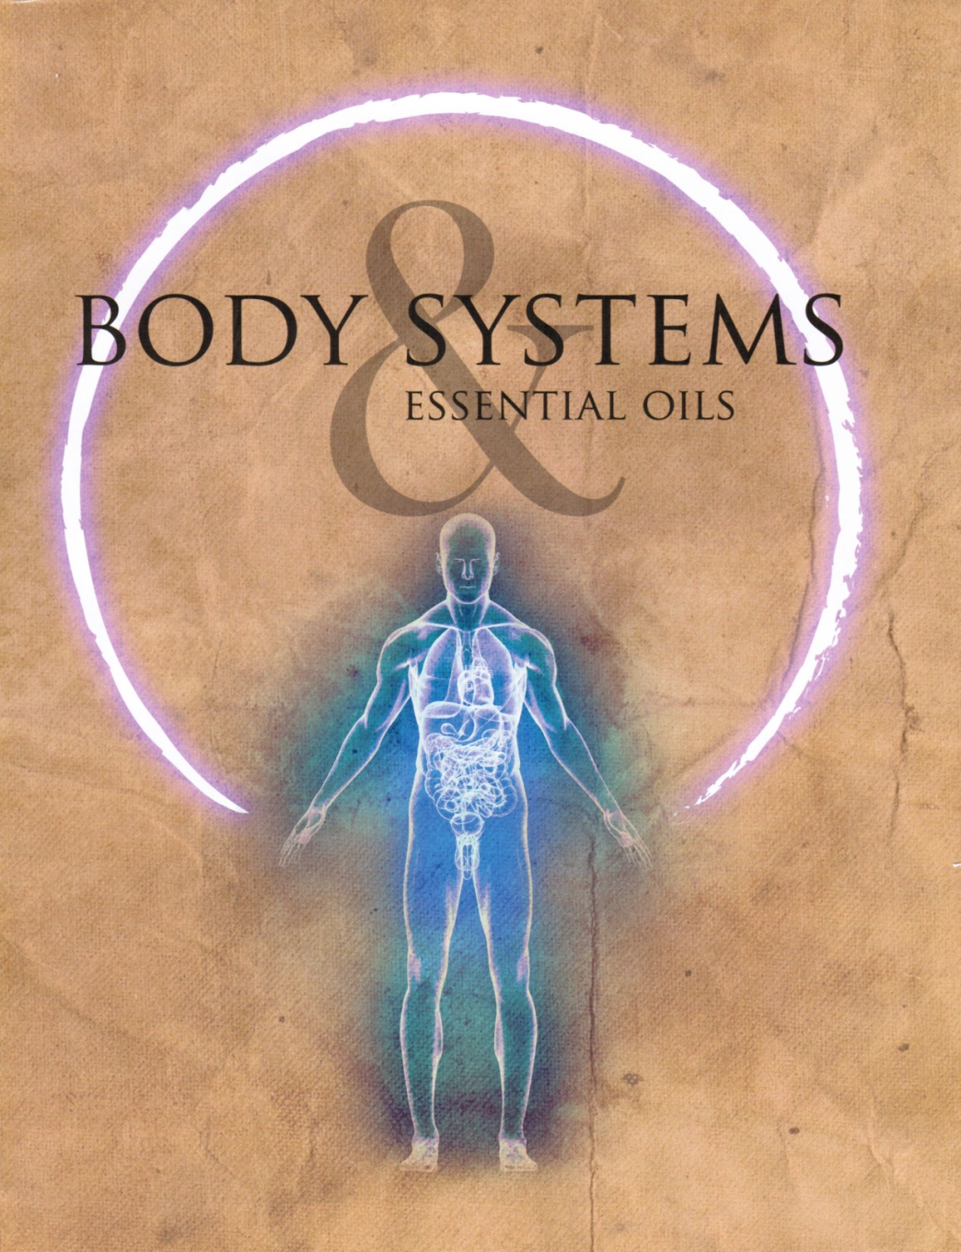
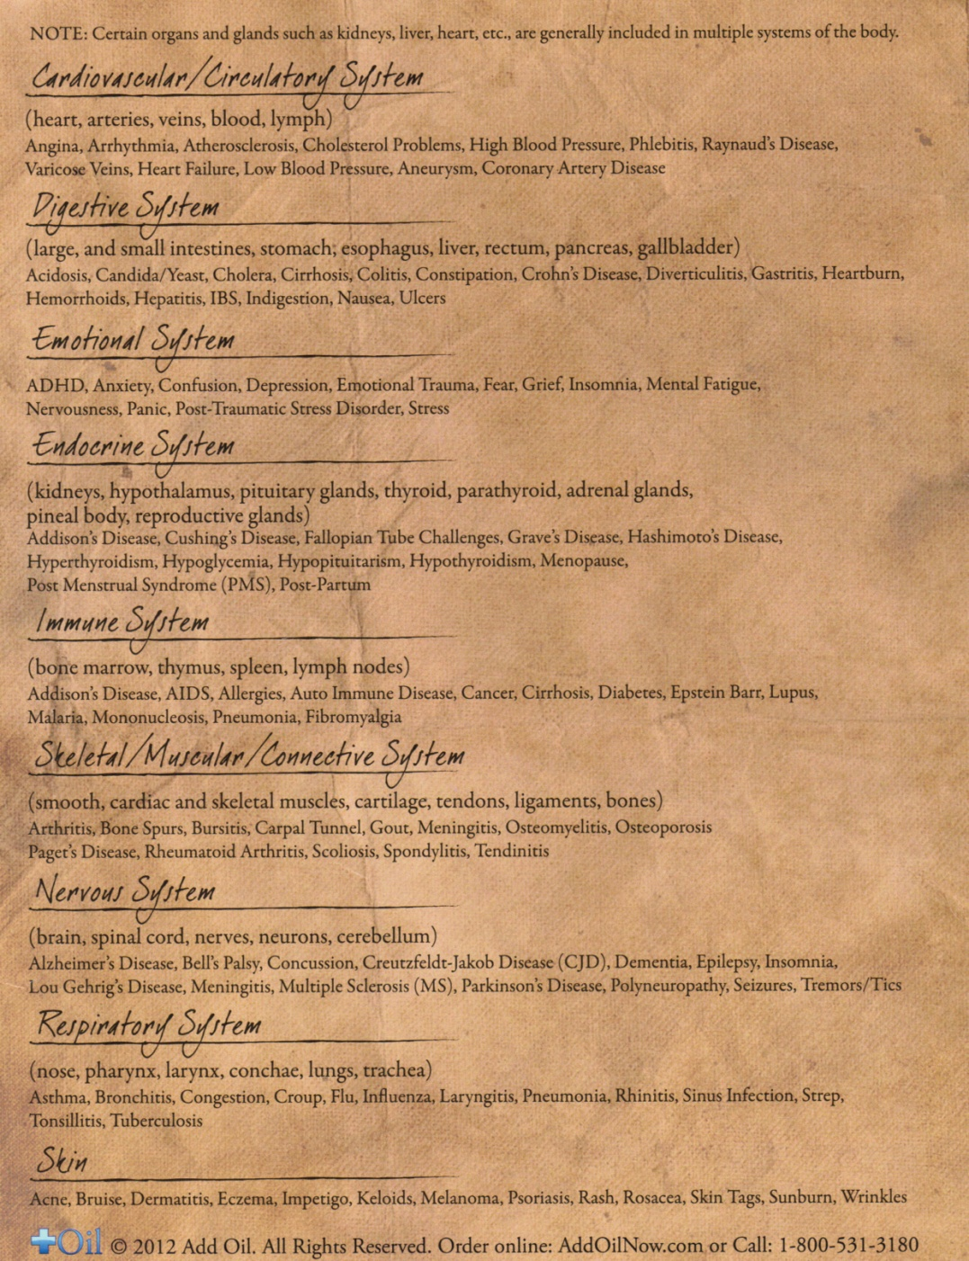

Slide 10
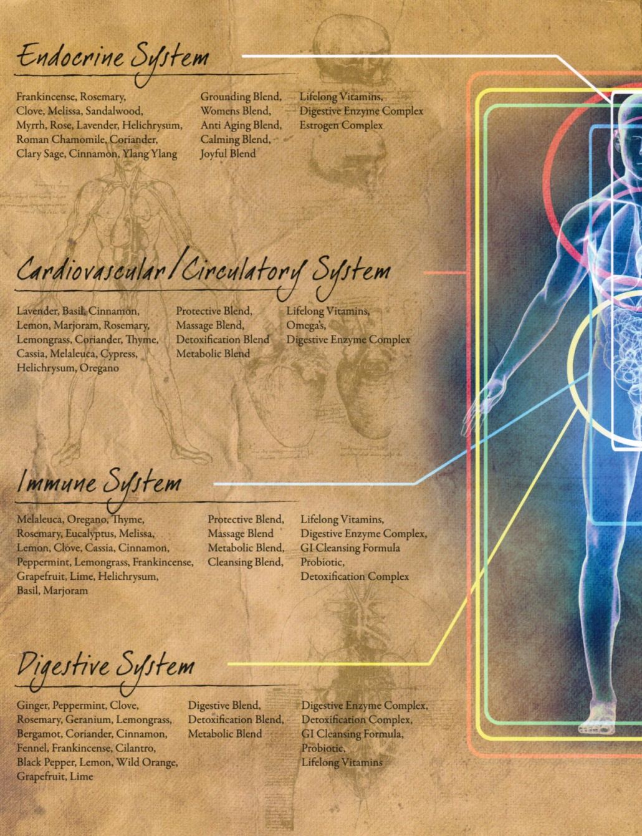
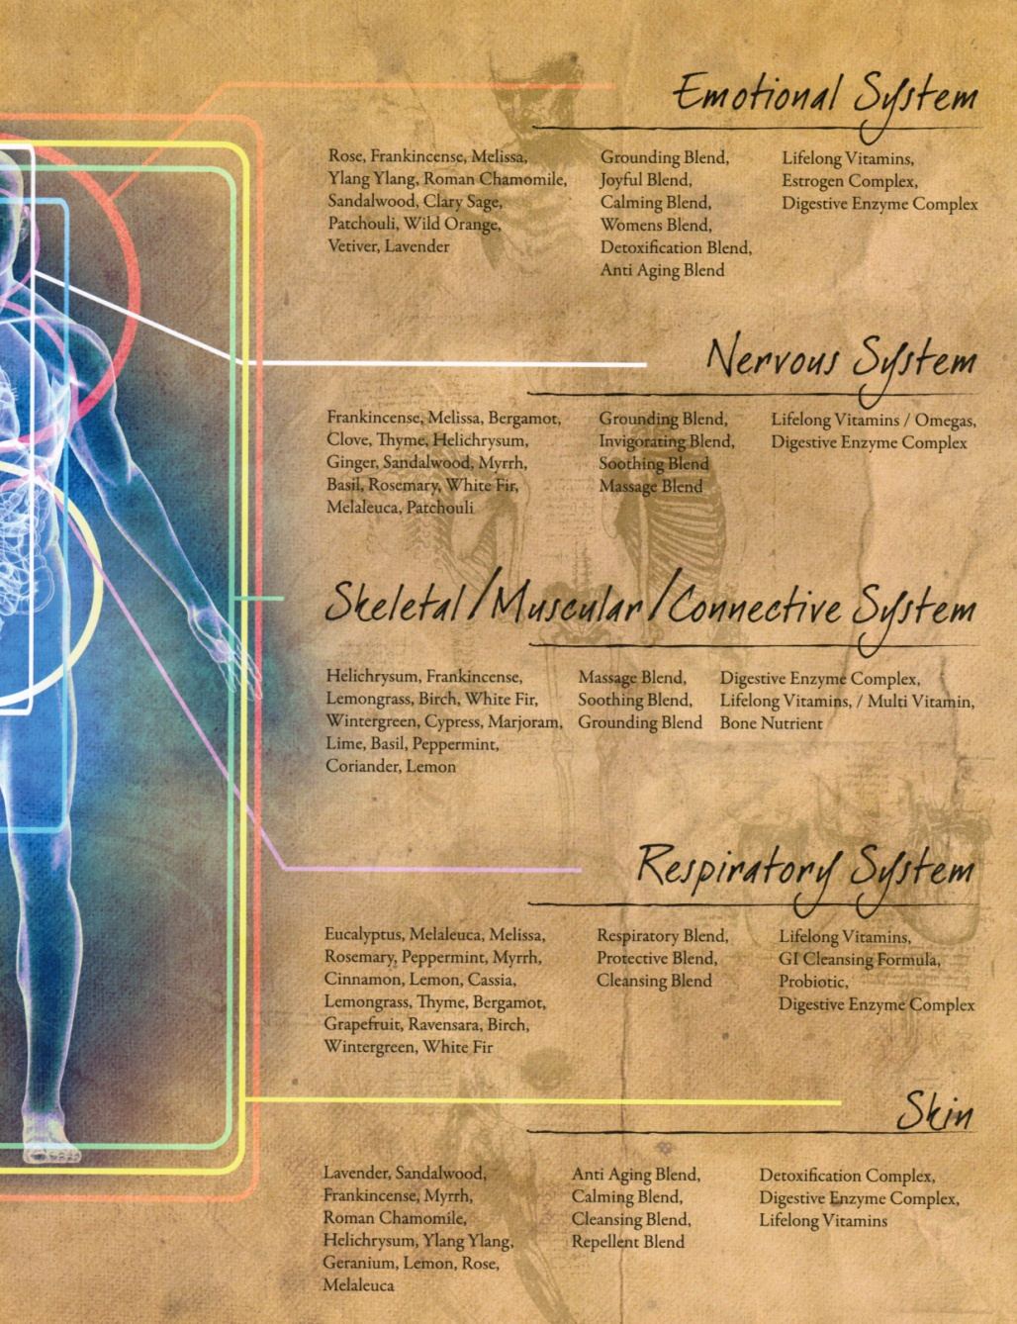

Slide 12
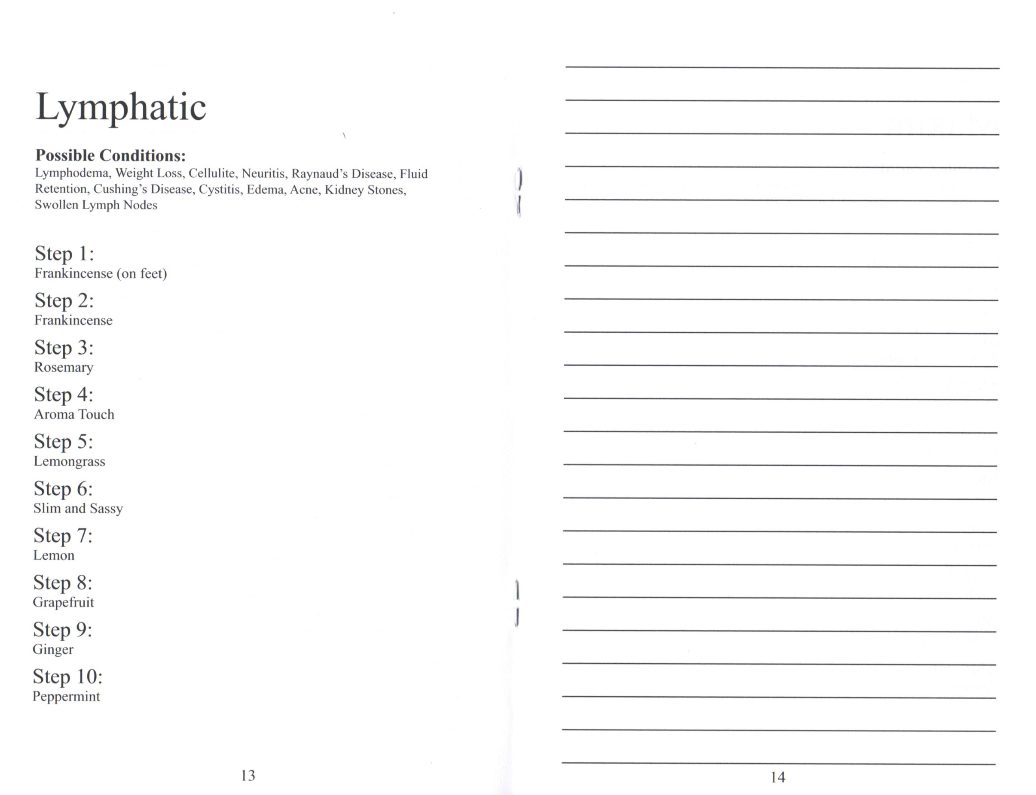

Slide 14
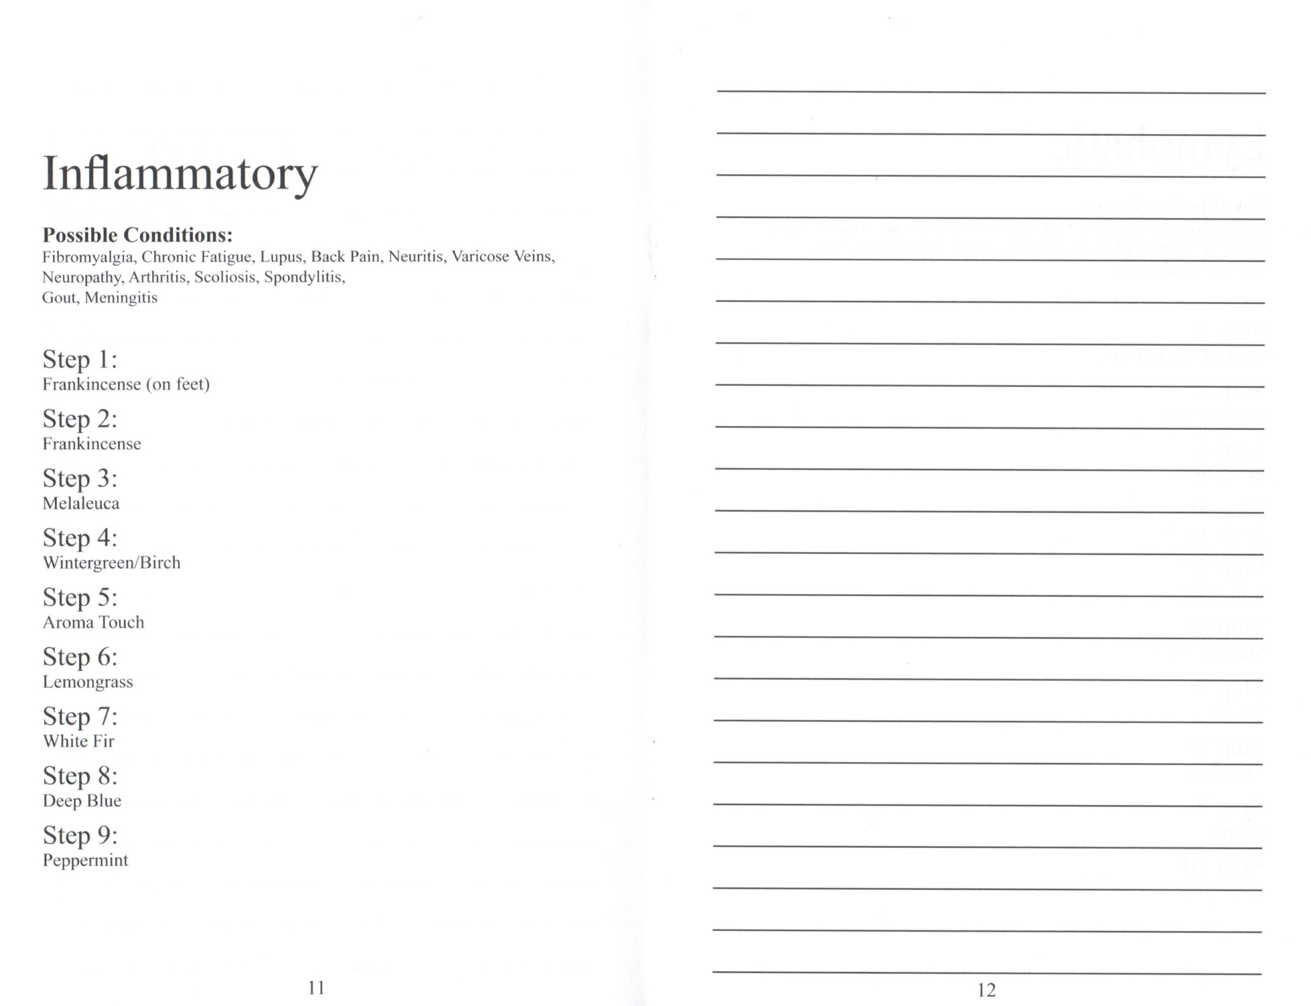

Slide 15
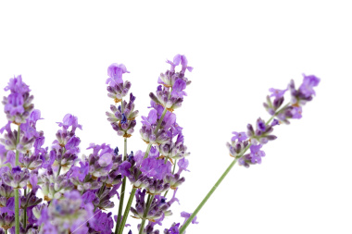
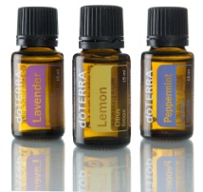
Symphony of the Cells
Drink a lot of water
Start with Frankincense
End with Peppermint (except Neurological)
Tailbone to base of skull
8 -10 drops
Add heat
Can turn red
Notes:
See Next slide for notes

